Slide 1
PRESS RELEASE
CONSUMER PRICE INDEX AND INFLATION
13th April 2022

Slide 2
In this release, we present:
Definition and Measurement of Consumer Price Index (CPI) and Rate of Inflation
CPI and Rate of Inflation for March 2022
Dominant Divisions of Rate of Inflation for March 2022
Disaggregation of Rate of Inflation for March 2022
Highlights of CPI and Rate of Inflation for March 2022

Slide 3
Definition and measurement of CPI and rate of inflation (1/3)
CPI measures changes in the price of a fixed basket of goods and services purchased by households
The assumption is that the basket is purchased each month, hence as price changes each month, the total price of the basket will also change
The rate of inflation is the relative change in CPI between periods
Inflation is reported year-on-year (annual inflation) and month-on-month (monthly inflation), and granulated to determine regional and commodity type and source of inflation
2
2

Slide 4
Definition and measurement of CPI and rate of inflation (2/3)
CPI does not measure price levels
CPI is a price perspective measure and cost-of-living index is an expenditure oriented measure
Data (market readings) are captured monthly
Key variables are prices, quantities and expenditure weights of items
Price reference year is 2018 (2018 = 100)
3

Slide 5
Definition and measurement of CPI and rate of inflation (3/3)
Prices are collected for approximately 39,500 products every month.
Price collection is done in 44 markets
Prices are collected from 7,726 outlets.
Products are ordered in a hierarchy of 13 Divisions, 44 Groups, 98 Classes, 156 Subclasses and 307 Items.
Every Item can only be part of one Subclass, and every Subclass can only be part of one Class, etc.
4

Slide 6
Consumer Price Index and Rate of Inflation for Mar. 2022
CPI for March 2022 was 148.8 relative to 124.7 in March 2021
Year-on-year inflation rate for March 2022 was 19.4%
This means that in the month of March 2022 the general price level was 19.4% higher than in March 2021
Month-on-month inflation between February 2022 and March 2022 was 4.0%
Month | CPI | Inflation |  | Quarterly Averages
 |  | Monthly | Yearly | Quarterly Averages
Feb-2021 | 123.6 | 0.8% | 10.3% | Q1: 10.2%
Mar-2021 | 124.7 | 0.9% | 10.3%
Apr-2021 | 126.6 | 1.5% | 8.5% | Q2: 7.9%
May-2021 | 127.6 | 0.8% | 7.5%
June-2021 | 129.2 | 1.3% | 7.8%
Jul-2021 | 131.3 | 1.6% | 9.0% | Q3: 9.8%
Aug-2021 | 131.7 | 0.3% | 9.7%
Sept-2021 | 132.5 | 0.6% | 10.6%
Oct-2021 | 133.3 | 0.6% | 11.0% | Q4: 11.9%
Nov-2021 | 135.2 | 1.4% | 12.2%
Dec-2021 | 136.9 | 1.2% | 12.6%
Jan-2022 | 139.7 | 2.1% | 13.9% | Q1: 16.3%
Feb-2022 | 143.0 | 2.4% | 15.7%
Mar-2022 | 148.8 | 4.0% | 19.4%
5
Notes:
Both Year-on-Year (3.7 percentage points) and Month-on-Month inflation (1.6 percentage points) for March 2022 steep relative to previous months.
Year-on-Year rate of inflation for March 2022 steeps (3.7 percentage points) relative to the upward trends recorded since May 2021.

Slide 7
Disaggregation of March 2022 rate of inflation
Food inflation was 22.4%
Last month this was 17.4%
Average over last 12 month was 11.8%
Month-on-month Food inflation was 4.5%.
Non-food Inflation was 17.0%
Last month this was 14.5 %
Average over last 12 month was 11.3%
Month-on-month Non-Food inflation was 3.7%
Inflation for locally produced items was 20.0%
Inflation for imported items was 17.3%
6
Notes:
Year-on-Year change in food inflation (five percentage points) between Feb. 2022 and March 2022 is twice non-food inflation )2.5 percentage points).
Year-on-Year change in food inflation is almost twice the 12-month rolling average from April 2021 to March 2022
Month-on-Month food inflation (4.5%) for March 2022 surpasses non-food (3.7%) by 0.8 percentage points.
The variation in domestic inflation (20.0%) and imported inflation (17.3) is 2.7 percentage points

Slide 8
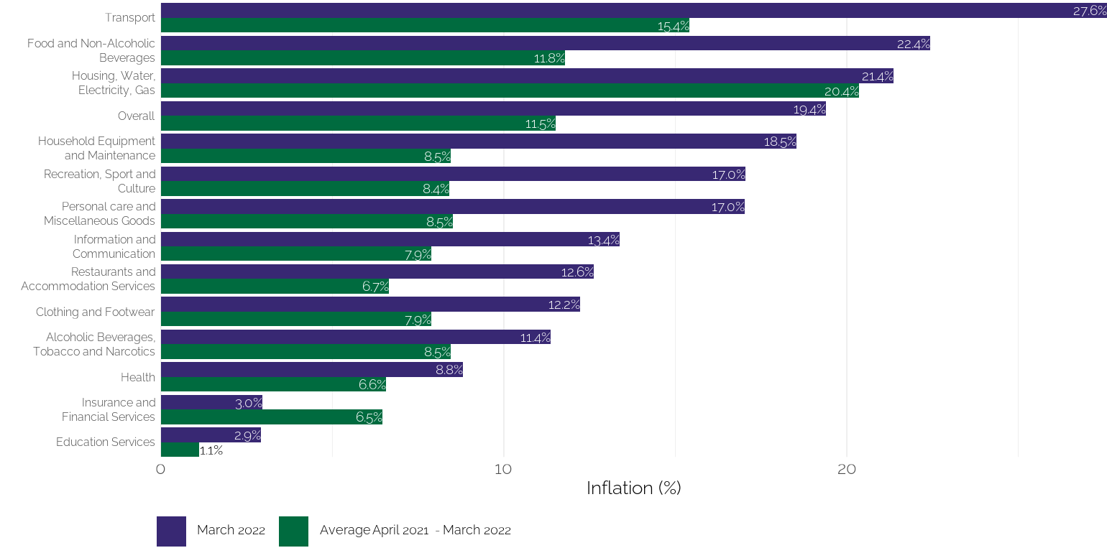
Disaggregation of year-on-year inflation by Division
7
Notes:
Across the 13 divisions, rank of the top three has changed in March 2022. Rate of inflation for Transport (26.6%) surpasses both Food and Non-Alcoholic Beverages (22.4%) and Housing, Water, Electricity and Gas (21.4%). All three record inflation rates higher than the national average (19.4%).
Inflation rates for four divisions in March 2022 [Household equipment and maintenance (18.5% vs. 8.5%) ; Recreation, Sports and Culture (17.0% vs. 8.4%) ; Personal Care and Miscellaneous Goods(17.0% vs. 8.5%) ; and Education Services(2.9% vs. 1.1%) ) are least twice the rates for the rolling average from April 2021 to March 2022.
Rate of inflation for Insurance and Financial Services for March 2022 (3.0%) is the only division that records a rate lower than the rolling average from April 2021 to March 2022 (6.5%)

Slide 9
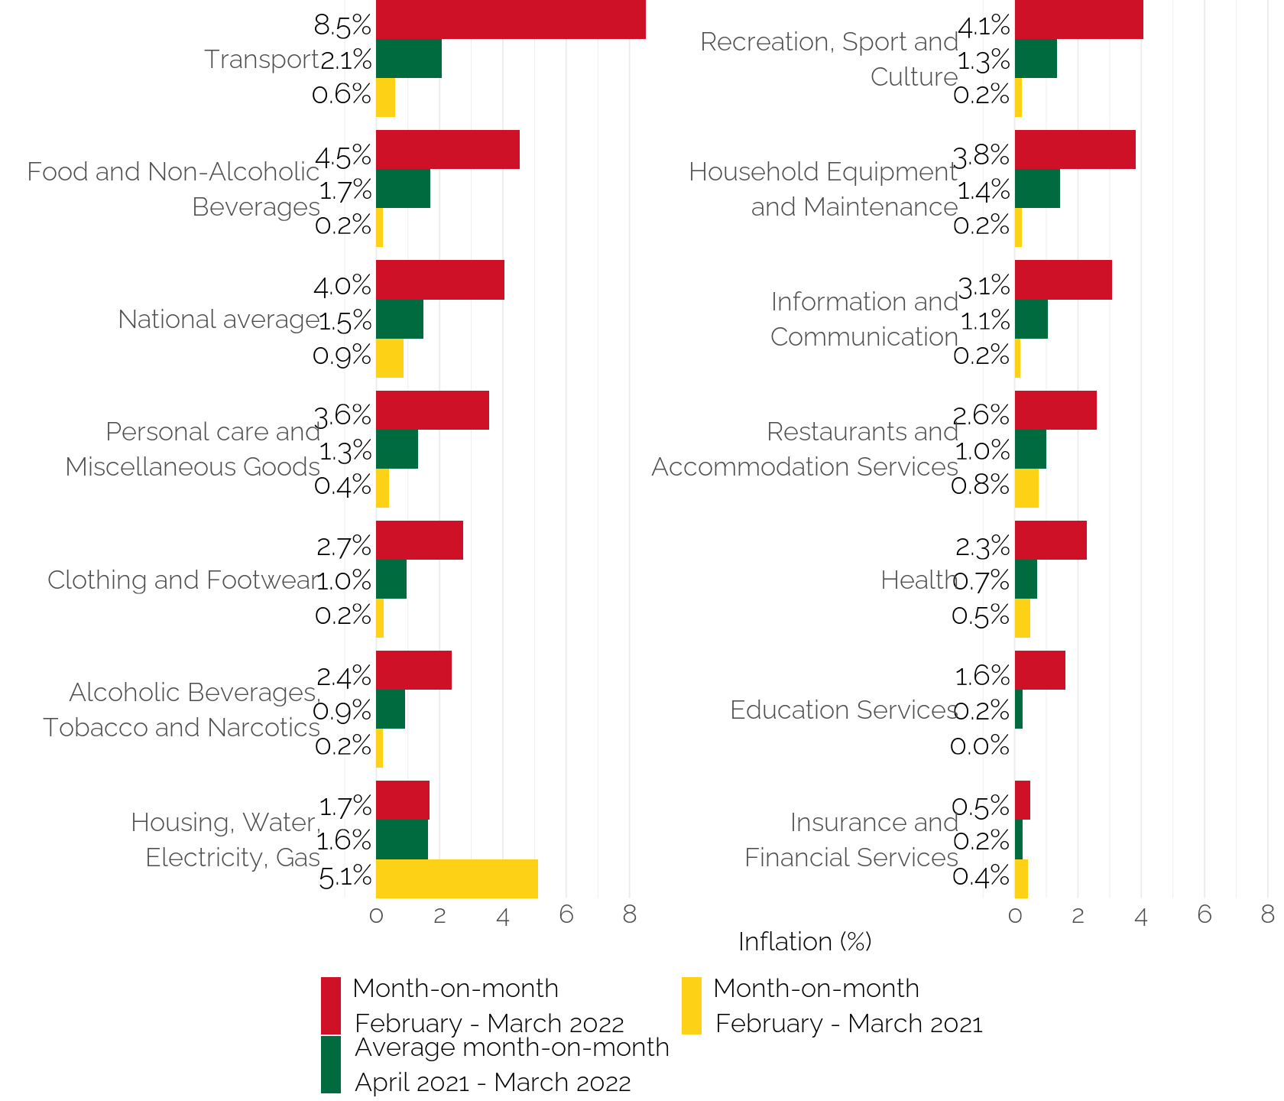
Disaggregation of month-on-month inflation
Notes:
On a Month-on-Month basis, all 13 divisions except Housing, Water, Electricity and Gas, record rates inflation higher than February 2022 and the rolling average from April 2021 to March 2022.
Transport (8.5%)recorded the highest with rate more than twice the national month-on-month inflation (4.0%) and food and non-alcoholic beverages had the second highest of 4.5%.
Insurance and Financial Services (0.5%) recorded the least month-on-month inflation

Slide 10
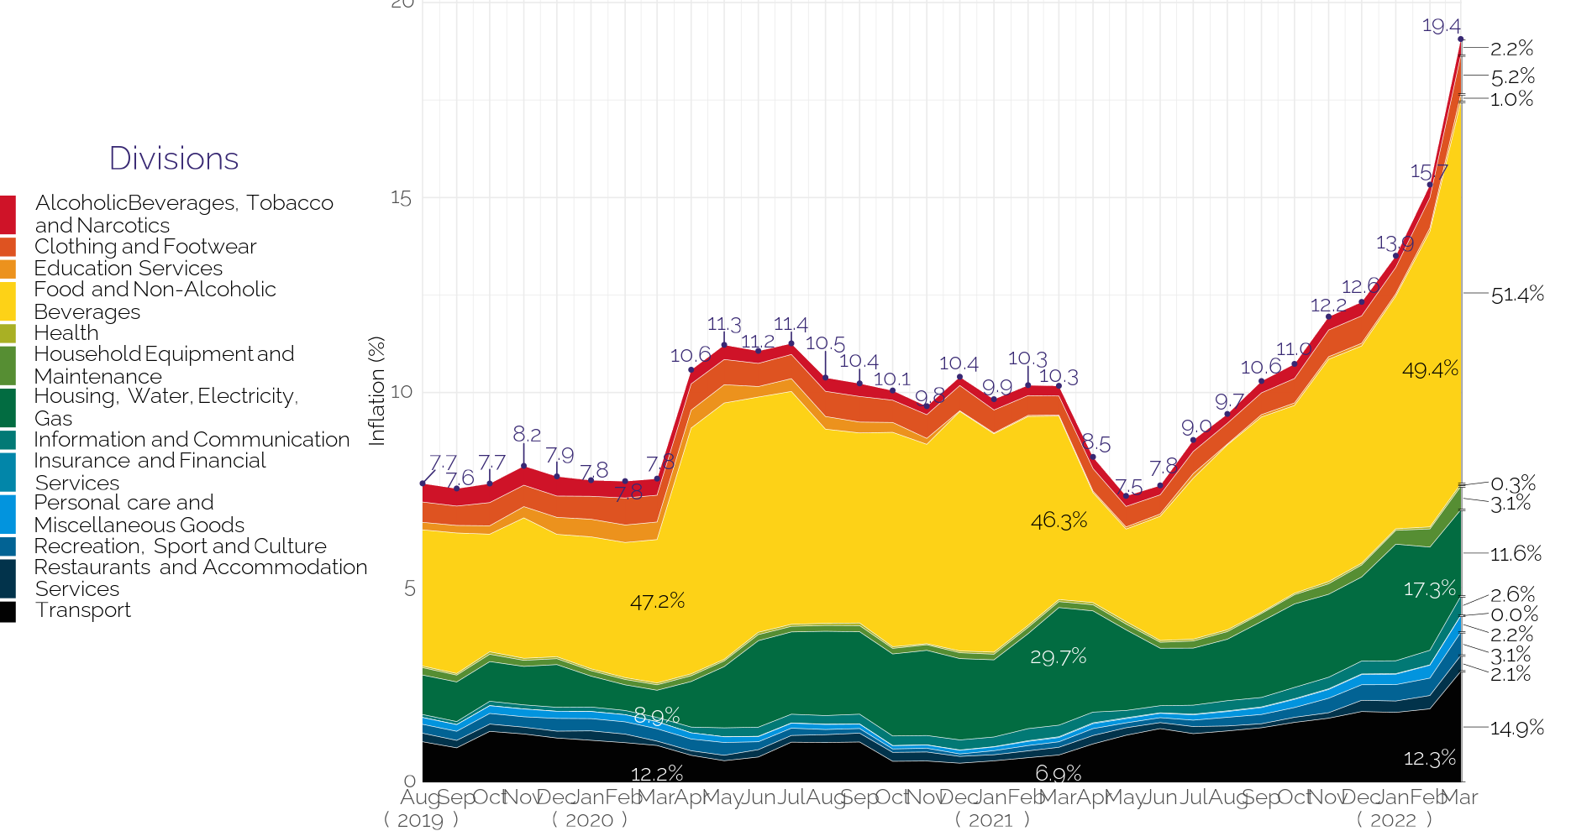
Composition of year-on-year inflation
9
Notes:
The contribution Food and non-alcoholic beverages (51.4%) to overall inflation exceeds 50%.
Significant jumps are observed for both Food and non-alcoholic beverages (from 49.4% to 51.4% - 2 percentage points) and Transport (from 12.3% to 14.9% - 2.6 percentage points).
The contribution of Housing, Water, Electricity and Gas (11.6%), shrinks by percentage points between February 2022 and March 2022.

Slide 11
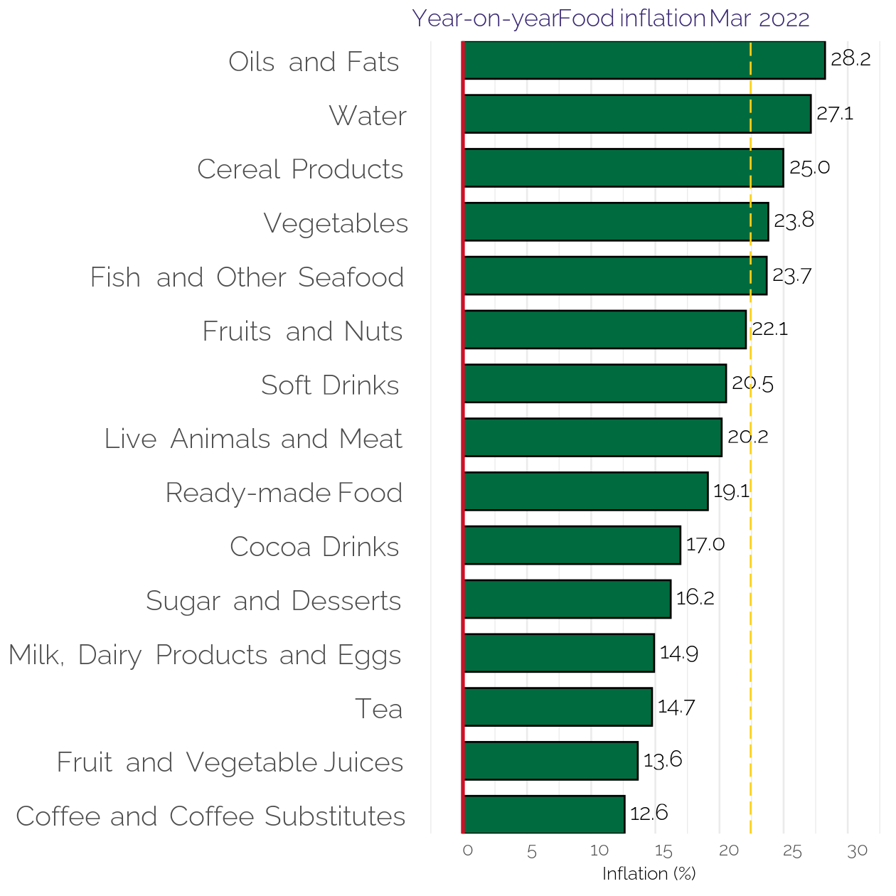
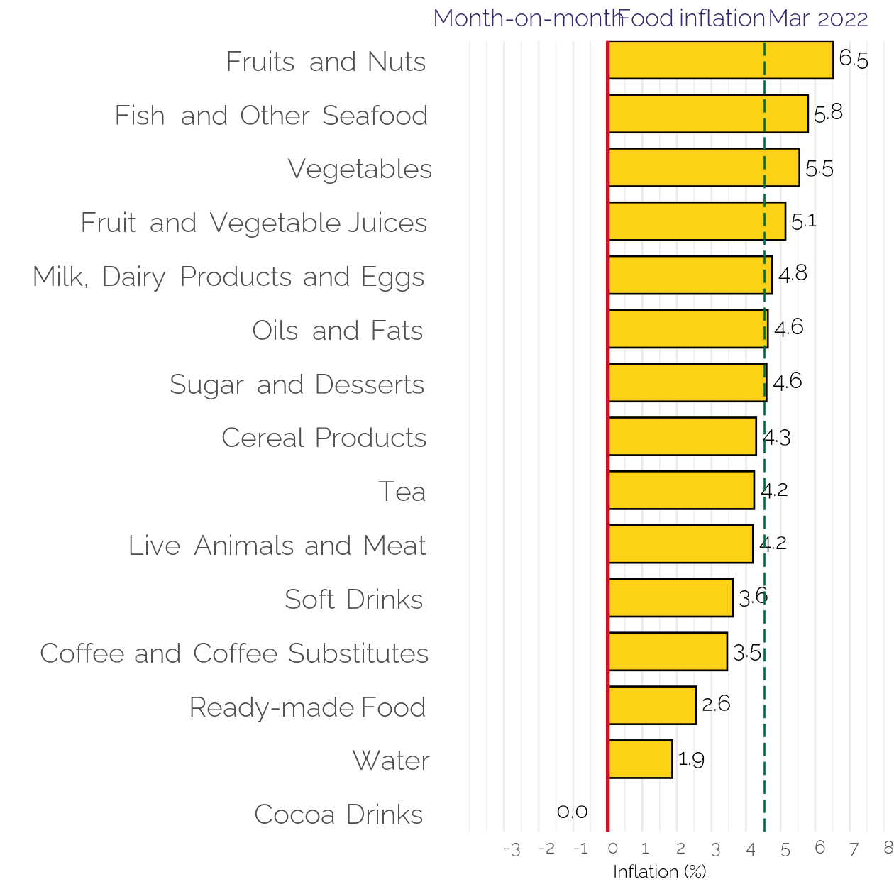
Disaggregation of YoY and MoM Food-inflation by Subclass
10
Notes:
With the food division and on a Year-on-Year basis, five sub-classes (Oils and Fats, Water, Cereal Products, Vegetables and Fish and Other Sea Food) record rates higher than the national average (22.4%).
Also on a Month-on-Month basis, seven sub-classes (Fruits and Nuts; Fish and Other Sea Food; Vegetables; Fruit and Vegetable Juices; Milk, dairy Products and Eggs; Oils and Fats; and Sugar and Desserts) record rates higher than the national average (4.5%).

Slide 12
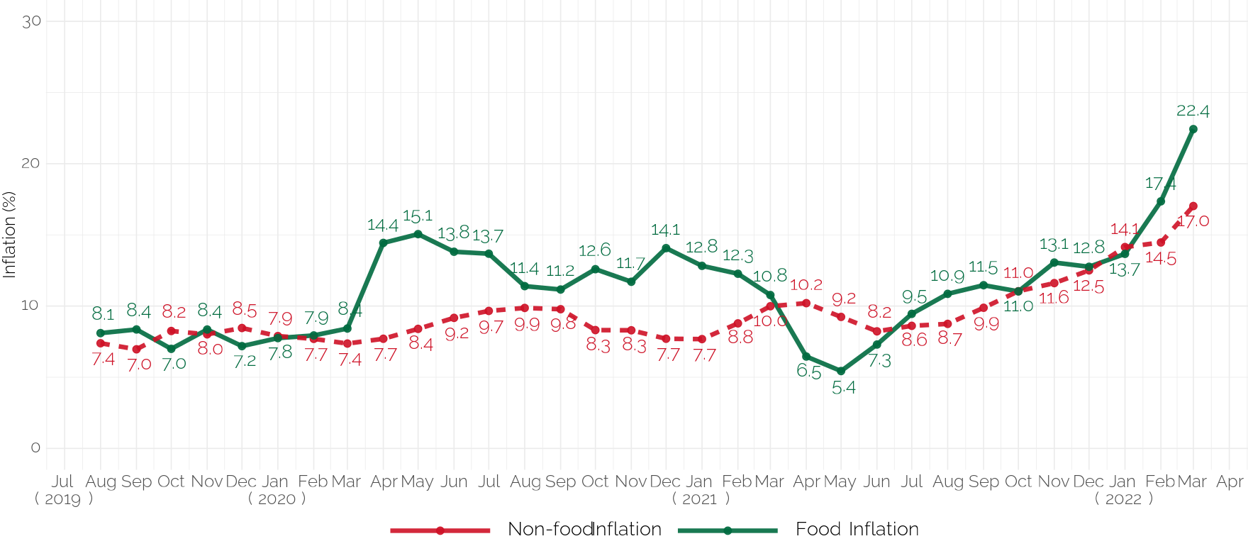
Food & Non-Food year-on-year inflation Jul. 19–Mar. 22
Notes:
Following near convergence reached between food and non-food inflation in Dec. 2021 and Jan. 2022, the widening gap with food surpassing non-food inflation has been widened in March 2022 to 5.4 percentage points, form 0.4 percentage points in February 2022.

Slide 13
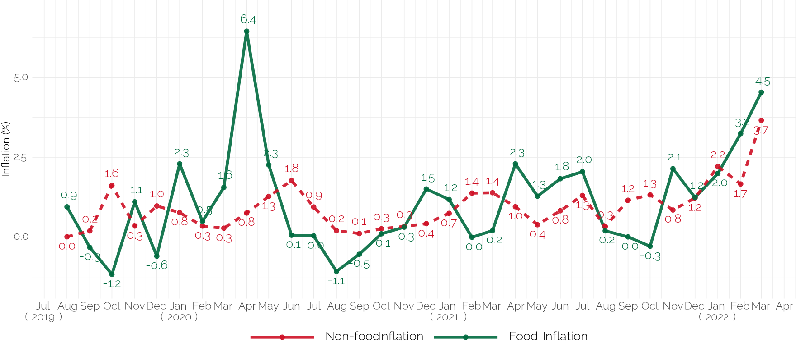
Food & Non-Food month-on-month inflation Aug. 2019–Mar. 2022
Notes:
For the periods Feb. 2022 and March 2022, the increase in month-on-month inflation for non-food inflation(1.7% to 3.7%) is steeper than food inflation (from 3.1% to 4.5%)

Slide 14
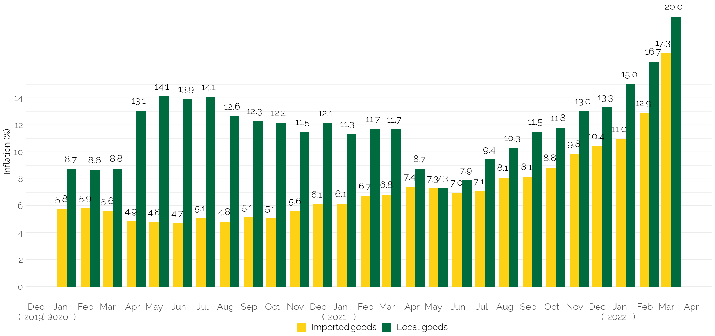
Imported and local inflation January 2020 – March 2022
Notes:
The gap between locally produced item and imported items is sustained in March 2022.

Slide 15
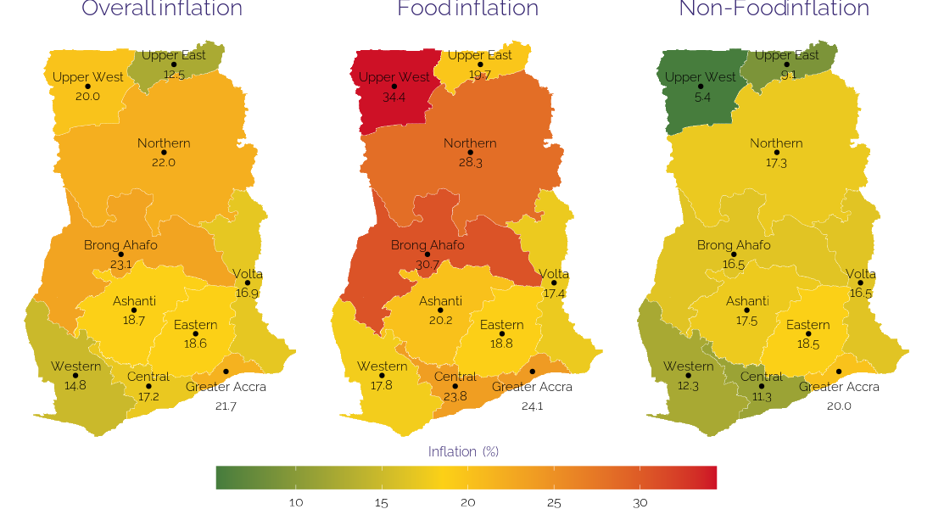
March 2022 regional rates of inflation
14

Slide 16
Disaggregation of inflation in Brong Ahafo Region for Mar. 2022
15

Slide 17
Highlights
Year-on-year inflation for March 2021 – March 2022 was 19.4%.
Month-on-month (February 2022 - March 2022) inflation was 4.0%.
Food inflation has extended its dominance over non-food (22.4% versus 17.0% respectively).
On a month-on-month basis food inflation exceeds non-food inflation by 0.8 percentage point (4.5% vs. 3.7%)
Transport (which includes fuel) recorded the highest inflation (27.6%) followed by Food and Housing (22.4% and 21.4% respectively)
Contribution of food and non-Alcoholic beverages to overall inflation increased by 2.0 percentage points this month from 49.4% in Feb. 2022 to 51.4% in Mar. 2022.
The gap between the inflation for locally produced items and imported items is retained
Brong Ahafo Region (23.1%) recorded the highest inflation and Upper East Region the lowest (12.5%)
16

Slide 18
End of Press Release for March 2021 Consumer Price Index
For enquiries, please contact:
https://statsghana.gov.gh/gssmain/fileUpload/Price%20Indices/CPI_Technical_Guide_v5_Published_14102020.pdf
Mr. John F.K. Agyaho
(Head, Price Statistics, GSS)
john.agyaho@statsghana.gov.gh

Slide 19
Consumer Price Index and Inflation
March 2021

